Slide 1

Source Code Management
Enterprise Application Development
Unit Code 425

Slide 2
Working Alone
Problems faced
Ever done one of the following ?
Had code that worked, made a bunch of changes and saved it, which broke the code, and now you just want the working version back…
Accidentally deleted a critical file, hundreds of lines of code gone…
Somehow messed up the structure/contents of your code base, and want to just “undo” the crazy action you just did
Hard drive crash ! Everything’s gone, the day before deadline.

Slide 3
Working in Teams
Problems faced
Whose computer stores the "official" copy of the project ?
Can we store the project files in a neutral "official" location ?
Will we be able to read/write each other's changes ?
Do we have the right file permissions ?
What happens if we both try to edit the same file ?
Bill just overwrote a file I worked on for 6 hours !
What happens if we make a mistake and corrupt an important file?
Is there a way to keep backups of our project files ?
How do I know what code each teammate is working on ?

Slide 4
Agenda
Source Code Management Concepts
Types of Source Code Managers
Tools used for Source Code Management
Continuous Integration
Introduction to Subversion (SVN)
Introduction to Git.

Slide 5
Source code Management
Introduction
Also known as Software Configuration Management
The task of tracking and controlling changes in the software
They include revision control and the establishment of baselines.
Source Code Managers are tools that,
Archive your development files
Serve as a single point of entry/exit when adding or updating development files

Slide 6
Source Code Management
The Need for a such a System
Supports concurrent development
Manage diverging source code bases
Records file/release versions
Easy access to all previous revisions
Can record why a revision was made – Revision History
Optimal disk space usage

Slide 7
Source Code Management
How they work
Central database of source code, documentation, build tools
Each file stored only once
Most of the times, all other versions are diffs of that one copy
To Make a Change
Check out the latest version of a file
Make the changes
Update the database

Slide 8
Code Sharing
sharing without control
One’s data may be accidentally overwritten by others.

Slide 9
Code Sharing
sharing with control
Multiple people can work on the same source base without conflicts
Locking (Lock-Modify-Unlock) Locks individual files so only one person at a time can modify it
Merging (Copy-Modify-Merge) Allows multiple people to modify a source file and the system will automatically merge the changes (usually)

Slide 10
Locking
Lock-Modify-Unlock
Only one person can work on a file at once

Slide 11
Locking
Lock-Modify-Unlock
Works fairly well if developers work on different areas of the project and don’t conflict often
Problem 1: People forget to unlock files when they are done
Problem 2: People work around locking by editing a private copy and checking in when the file is finally unlocked
Easy to goof and lose changes !

Slide 12
Merging
Copy-Modify-Merge
Several people can work on a file at once
Before committing changes, each user merges their copy with the latest copy in the database
This is normally done automatically by the system and usually works, but you should not blindly accept the result of the merge

Slide 13
Merging
Copy-Modify-Merge

Slide 14
Types of SCM Tools
Centralized Version Control
Distributed Version Control

Slide 15
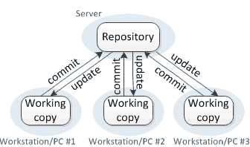
Types of SCM Tools
Centralized Version Control
Takes a client-server approach to version control.
All clients synchronize over a single, central repository.

Slide 16
Types of SCM Tools
Centralized Version Control
Advantages
Simple client-server implementation
Disadvantages
An active connection to the repository is needed to commit code.
Central repository is a single point of failure !
Easy administration and management.

Slide 17
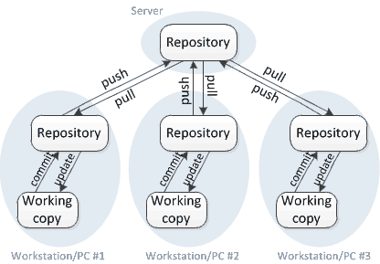
Types of SCM Tools
Distributed Version Control
Takes a peer-to-peer approach to version control.
Each peer's working copy of the codebase is a complete repository.

Slide 18
Types of SCM Tools
Distributed Version Control
Advantages
An active connection is not necessary to commit code.
Disadvantages
Complex by design.
Can recover from repository failures as they are distributed.
Administration and management is difficult.

Slide 19
Tools
Source CODE managers
Centralized SCM Tools
Subversion (SVN)
CVS (Concurrent Versions System)
Harvest
Distributed SCM Tools
Git
Mercurial
Bazaar

Slide 20
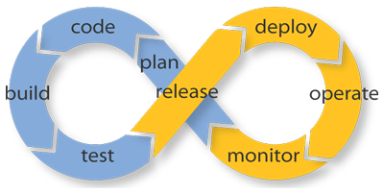
Continuous integration

Slide 21
Continuous integration
overview
A development practice that requires developers to integrate code into a shared repository several times a day.
Each check-in is then verified by an automated build, allowing teams to detect problems early.
By integrating regularly, you can detect errors quickly, and locate them more easily.

Slide 22
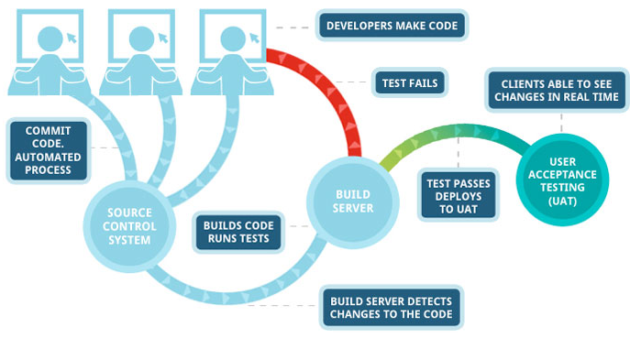
Continuous integration
workflow

Slide 23
Continuous integration
Tools
Jenkins/Hudson
Bamboo
CruiseControl
TeamCity

Slide 24

Introduction to Subversion

Slide 25
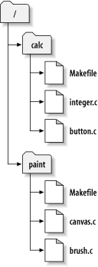
Introduction to Subversion
overview
Subversion (abbreviated SVN) is a free and open-source version control system.
Managed folders/files are placed into a repository. A repository is much like an ordinary file server.
Subversion allows you to recover old versions of your data, or examine the history of how your data changed.
checkout
Working copy
SVN Repository

Slide 26
Introduction to Subversion
Clients and Plugins
SVN Clients for Windows:
Tortoise SVN
Smart SVN
Rapid SVN
Visual SVN
SVN Plugin for Eclipse:
Subclipse
SVN Plugin for Visual Studio .NET:
AnkhSVN
Company
Server
SVN
Repository
Checkout / Commit
TortoiseSVN
TortoiseSVN
TortoiseSVN
Working
copy
Working
copy
Working
copy
Member 1 desktop
Member 2 desktop
Member n desktop

Slide 27
Introduction to Subversion
Terminology
Checkout – Get a local copy of the files
I have no files yet, how do I get them?
Add – Add a new file into the repository
I created a new file and want to check it in
Commit – Send locally modified files to the repository
I’ve made changes, how do I send them to the group?
Update – Update all files with latest changes
Other people made changes, how do I get them?
Tag / Branch – Label a “release”
I want to “turn in” a set of files
Notes:
Training –

Slide 28

Introduction to Subversion
Common Functions
Browse repository
Add file/folder to repository
Check out a working copy
Lock/Release repository files
Commit to repository
Check for modifications
Update working copy
Revision log dialog
View differences
Clean up
Status of version controlled files/folders

Slide 29
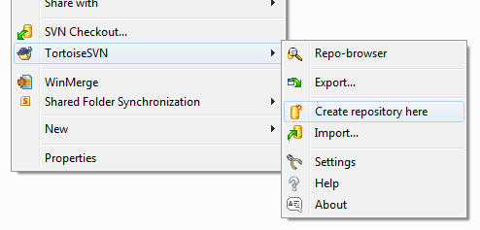

Create a repository
using Tortoise SVN
Open Windows Explorer
Select a directory where you want your repository
Right-click and select “Create Repository Here…”
Done by Admins

Slide 30
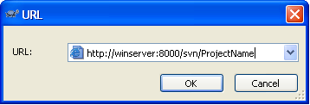
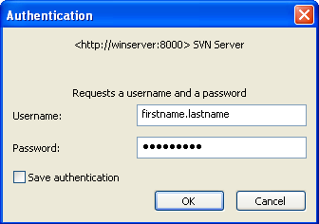
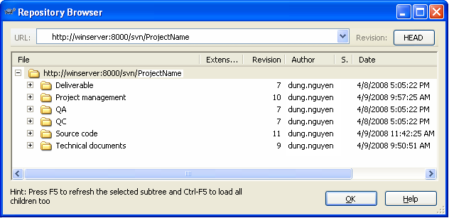
Browse Repository
In Windows Explorer, right click>TortoiseSVN>Repo-browser
Put the repository URL into the dialog box
Login with given username and password
The Repo-browser opened
Notes:
https://cmbtrnfs01.corpnet.ifsworld.com/svn/SVN_Training/

Slide 31
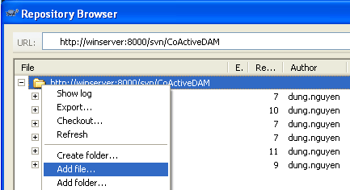
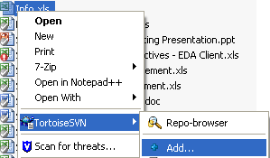
Add file/Folder
Without (local) working copy folder
In Repo-browser, right click>Add folder…
Select source file/folder to be added
New files/folders will be added under current selected folder.
With (local) working copy folder (recommended)
Copy new file/folder to the working copy folder
In Windows Explorer, select new file/folder, right click>TortoiseSVN>Add…
TortoiseSVN>Commit…
New file/folder has a check mark.

Slide 32
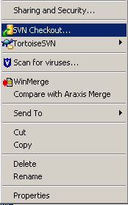
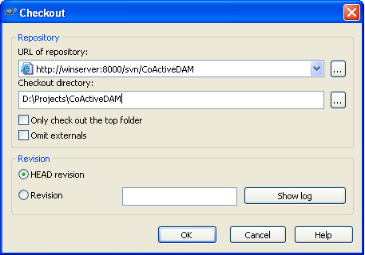
Check out a working Copy
In Windows Explorer, select working folder, right click>SVN Checkout… OR
In Repo-browser, select the folder to check out, right click>Checkout…
Desired revision

Slide 33
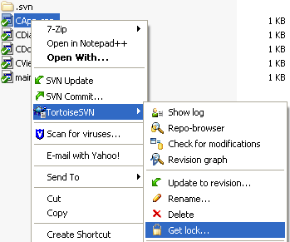
Lock/Release repository files
This is to avoid the conflict when another user updates the repository while you are working on your working copy.
In the working copy, select file to lock, right-click>TortoiseSVN>Get lock…
Locked file has a lock-icon mark. Other users will not be able to commit until you release the locked files.

Slide 34
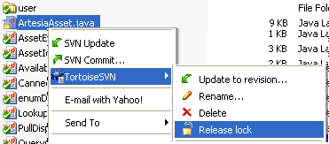
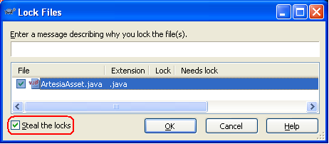
Lock/Release repository files
This is to release the locked files for others to commit.
Select locked file>TortoiseSVN> Release lock
Steal the locks:
Select locked file>TortoiseSVN> Get lock…
Check Steal the locks
This way will steal other’s lock and replace by your lock. Not recommended. It’d be better to ask the author to release his lock.

Slide 35
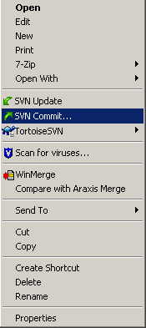
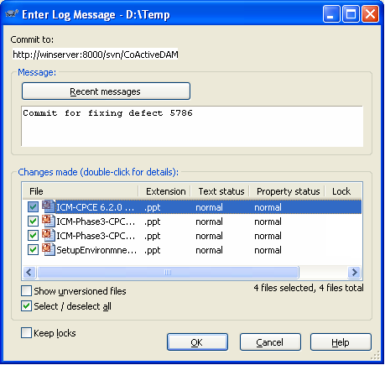
Commit to repository
This is to send the changes you made on working copy to the repository.
On the working copy, right click>SVN Commit…
Before committing, you should make sure that your working copy is up-to-date
Should give comments

Slide 36
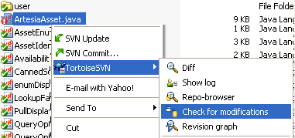

Check modification
This is to know the modification status of selected file in comparison with that file on the repository.
On working copy, select modified file.
Right click>TortoiseSVN> Check for modifications
The Working Copy dialog shows the status of the selected files in comparison with that file on the repository.

Slide 37
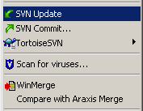
Update working copy
This is to update your working copy with new changes on the repository.
Periodically, you should ensure that changes done by others get incorporated in your working copy.
On the working copy, select folder to be updated, right click>SVN Update…

Slide 38
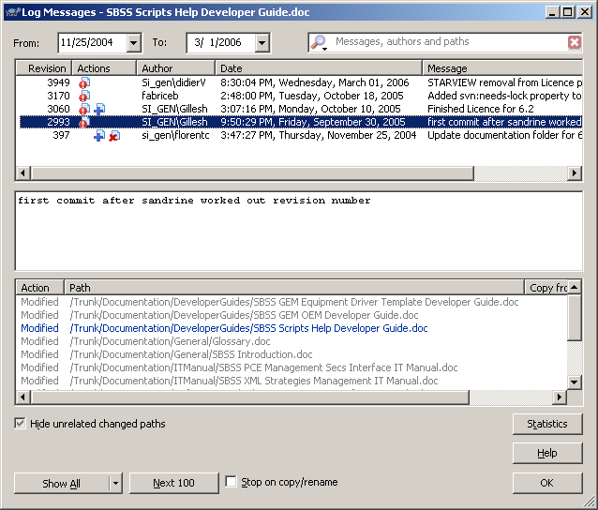
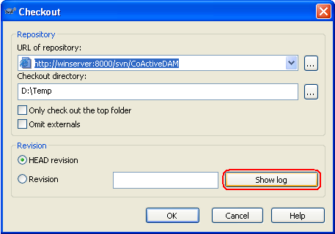
Show Revision Log Message
For every change you make and commit, should provide a log message describes the meaning of your change.
The Log Messages dialog retrieves all those log messages and allows you to select the desired revision.
Revision number is applied for the whole repository.

Slide 39
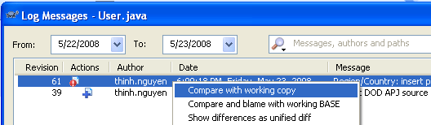
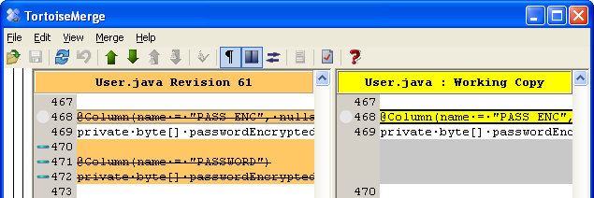
View Differences
Compare working copy with a given SVN revision.
On working copy, select file to compare
Right click>Show log => Log messages dialog opened
Select the revison to compare, right click>Compare with local copy

Slide 40

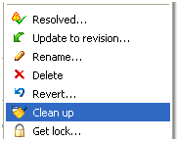
Clean up
If a Subversion command cannot complete successfully, perhaps due to server or network problems, your working copy can be left in an inconsistent state.
It is a good idea to do “clean up” at the top level of the working copy.

Slide 41







File/Folder Status
Green checkmark: normal status, under control
Red exclamation: file has been modified since last update and needs to be committed.
Yellow exclamation: a conflict occurs during an update.
Grey checkmark: this file needs to be locked first before editing.
Locked lock: file is locked. Need to unlock for other to commit.
Red deletion: missing file or file to be deleted under version control.
Blue plus: File to be added to version control.

Slide 42

Introduction to Git

Slide 43
Introduction to Git
overview
Git is a free and open source distributed version control system.
It was initially designed and developed by Linus Torvalds, the creator of the Linux Kernel.
Widely used with the command line interface, but a number of GUI tools exists.
One of the most widely adopted version control systems for software development.

Slide 44
Introduction to Git
Clients and Plugins
Git Clients for Windows:
SourceTree
SmartGit
Git Extensions
GitEye
SVN Plugin for Eclipse:
EGit
SVN Plugin for Visual Studio .NET:
Git Extensions
Native support from Visual Studio 2012

Slide 45
Introduction to Git
Terminology
Clone – Create a local copy from an online repository
Commit – Send locally modified files to the local repository
Fetch - Get the latest changes from a repository without merging them
Pull – Fetch changes from a repository and merge them into local copy
Push – Send committed changes to a remote repository
Remote – An online repository
Notes:
Training –

Slide 46
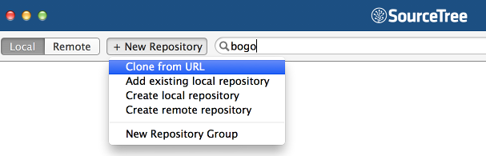
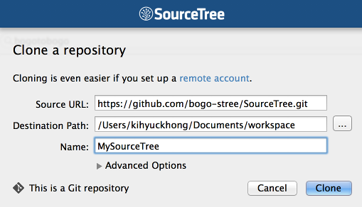
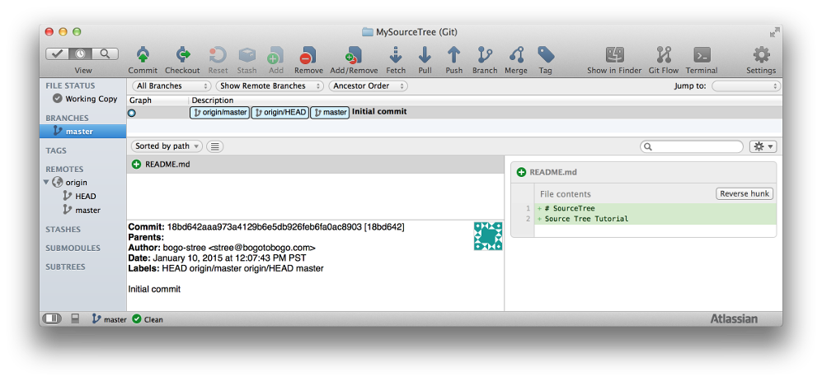
Introduction to Git
Clone repository
Notes:
Training –

Slide 47
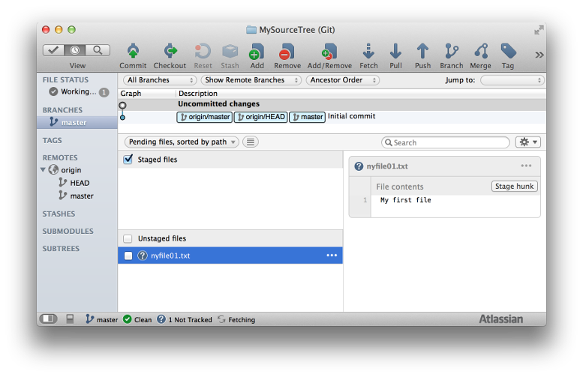
Introduction to Git
Staged & Unstaged
Notes:
Training –

Slide 48
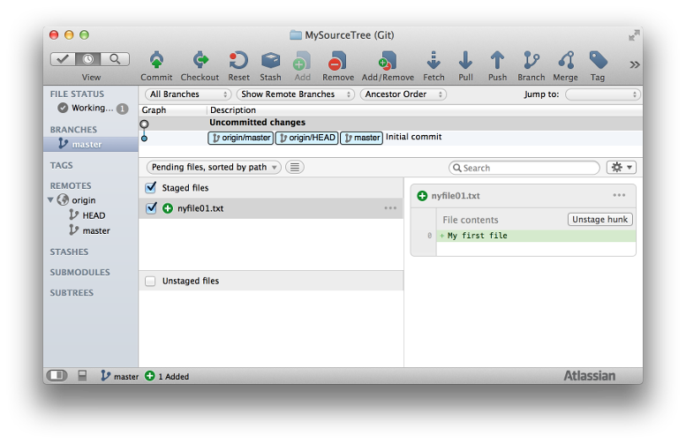
Introduction to Git
Staged & Unstaged
Notes:
Training –

Slide 49
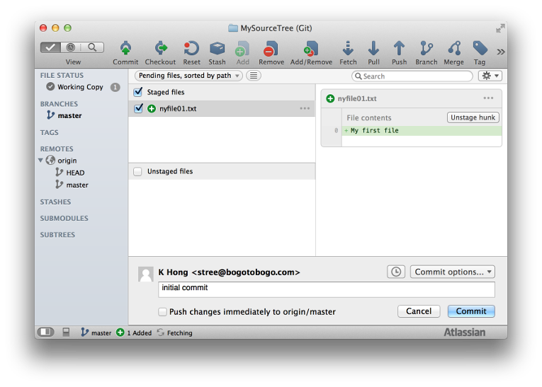
Introduction to Git
Commit to the Local Repository
Notes:
Training –

Slide 50
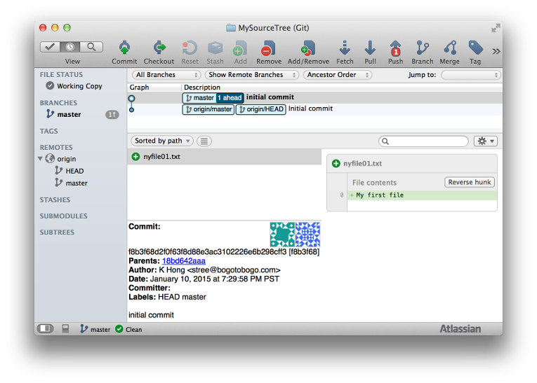
Introduction to Git
Commit to the Local Repository
Notes:
Training –

Slide 51
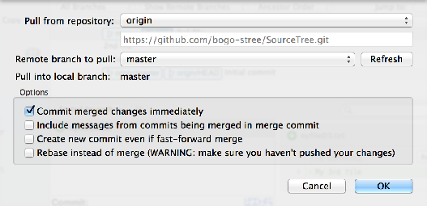
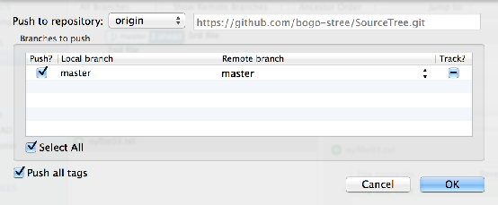
Introduction to Git
Pushing to GitHub
Notes:
Training –

Slide 52
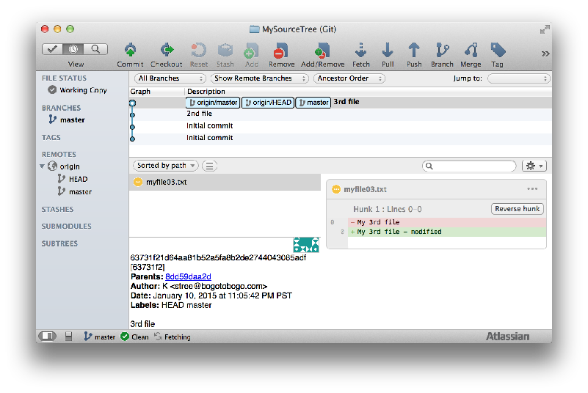
Introduction to Git
PULLING FROM GitHub
Notes:
Training –

Slide 53

Questions …

